Slide 1
Performance Based Communication and Surveillance (PBCS)
Data Link Operational Authorization Process
Presented to: ICAO Asia-Pacific RCP/RSP Workshop (Bangkok, Thailand)
By: Tom Kraft (for Trent Bigler) tom.kraft@faa.gov
Date: 13-14 May 2013

Slide 2
Introduction
ICAO Annex 6, Chapter 7
Advisory Circular AC 120-70B
7 Part Checklist / Job Aid
A056 Operations Specification
Proposed Additions

Slide 3
Operational authorization requirement
ICAO Annex 6, Chapter 7
7.1.3 For flights in defined portions of airspace or on routes where an RCP type has been prescribed, an aeroplane shall, in addition to the requirements specified in 7.1.1:
a) be provided with communication equipment which will enable it to operate in accordance with the prescribed RCP type(s); and
b) be authorized by the State of the Operator for operations in such airspace

Slide 4
How does the FAA accomplish operator authorization?
Advisory Circular (AC) 120-70B Operational Authorization for Use of Data Link Communication System
FAA design approval of data link system
Revision to CFR 121, 125, 125M 135 Op Specs
Revision to CFR 91K M Specs, CFR 91 LOA
FAA Job Aid - a 7-part “how to” guide that outlines entire process
A056 (data link) Operations Specification

Slide 5
AC 120-70B
Applicability – Code of Federal Regulations (CFR) parts 91, 91K, 121, 125, 129 and 135
Describes the process of obtaining Operational Authorization for data link systems, acceptable training and maintenance, and operational polices for use
Actions in event of an ATC data link communications event

Slide 6
AC 120-70B Chapter 8
Installation of a data link communication system requires FAA approval of changes to Type Certificate (TC) or Supplemental Type Certificate (STC)
Approval of installation does not constitute authorization to use the system
Design approval of aircraft data link systems in accordance with AC 20-140B “Guidelines for Design Approval of Aircraft Data Link Communication Systems”

Slide 7
7 Part Checklist / Job Aid
Basic Events in data link authorization process
Recommended Inspector and Operator actions
General Operator information
Operator exhibits and documents submitted
Content of Operator application
Basic pilot procedures
Data link maintenance program

Slide 8
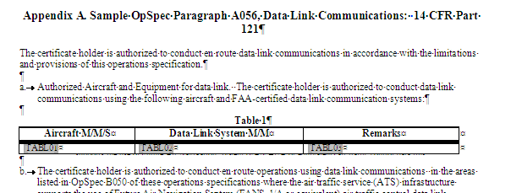
A056 (Data Link) OPS SPEC
A-5a
Revisions needed to A056 OPS SPEC template and associated FAA Orders / ACs to include PBCS

Slide 9
A056 OPS SPEC changes being considered
Operator obtains operational authorization, as appropriate, in accordance with National regulations; GOLD and RCP – RSP specifications provide criteria for operations and maintenance
Contractual arrangements/service agreements with CSP(s)/SSP(s)
Operator demonstrates 6 months of acceptable RCP/RSP performance for the aircraft types in their fleet
If substandard performance, ANSP and/or State of the Operator or State of Registry issues corrective action notice
Considers severity of the deficiency and magnitude of the change
If non-compliance remains after the date indicated in the corrective action notice State of the Operator or State of Registry could remove the RCP [X] – RSP [Y] authorization
The operator may still use CPDLC and ADS-C

Slide 10
Conclusion
Operational authorization process provides a means for the State of the Operator or State of Registry to fulfill its obligation to ensure that Air Operators maintain and operate aircraft and systems, considering
ICAO Annexes
Procedures for Air Navigation Services (PANS
National Regulations and
Airspace requirements (e.g. 7030, AIPs, AICs etc.)

